Slide 1
.NET 8: Performance Improvements in .NET MAUI

Slide 2
.NET MAUI: Fundamentals & Quality
.NET 8 timeframe:
Merged 1,618 pull requests that closed 689 total issues
Performance goals:
Aim to be slightly better than .NET 7
.NET 8 includes some interesting performance improvements.
aka.ms/mauiperf8

Slide 5
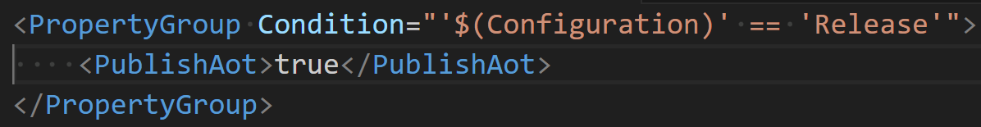
NativeAOT on iOS, Experimental Support
NativeAOT is not Mono -- basically a new runtime
NativeAOT apps have faster startup time and smaller memory footprints
Future/.NET 9 plans
Improve “trimmability” of .NET MAUI: https://github.com/dotnet/maui/issues/18658
Experiment how NativeAOT might work on Android

Slide 6
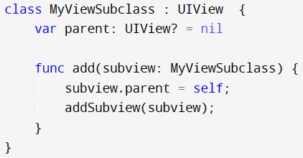
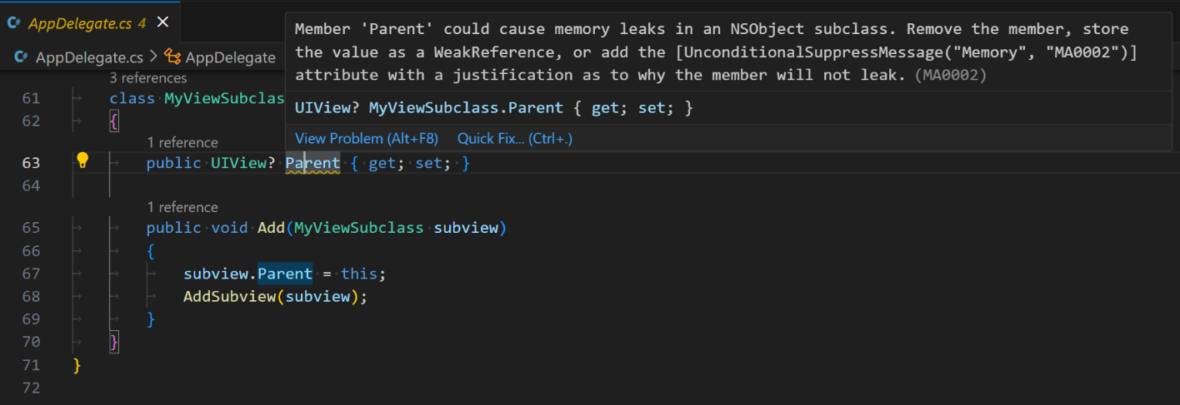
Memory Leaks on Apple Platforms
https://aka.ms/maui-memory-leaks
Roslyn analyzer for iOS circular references
Take for example the following Swift code:
Parent -> Child, and Child -> Parent
The same situation can occur in C#

Slide 7
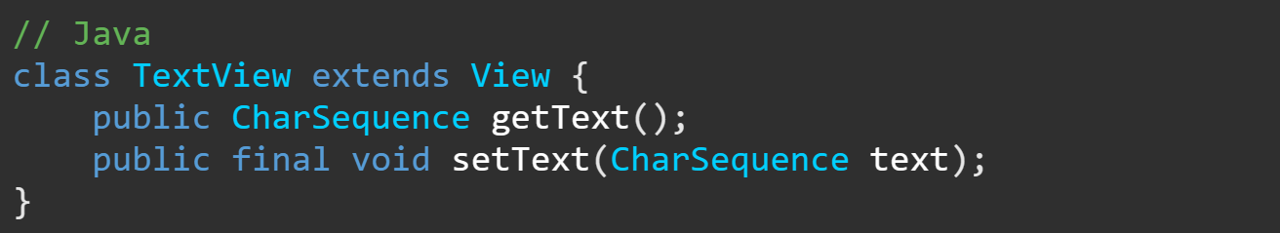
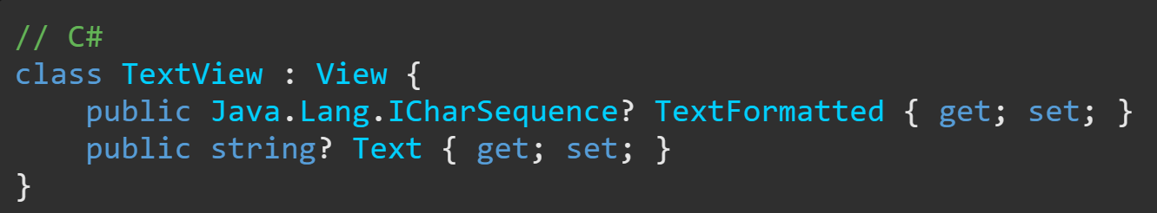
Android: Improvements in Java interop

Slide 8
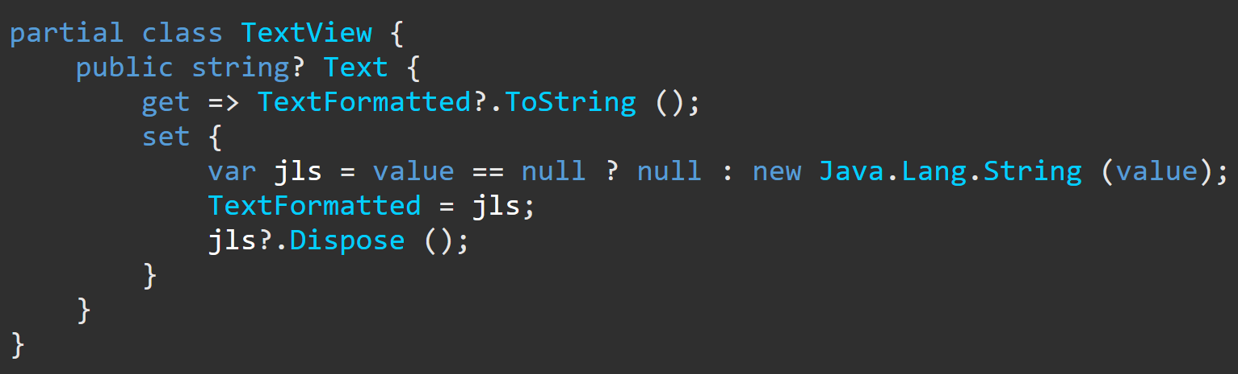
Android: Improvements in Java interop

Slide 9
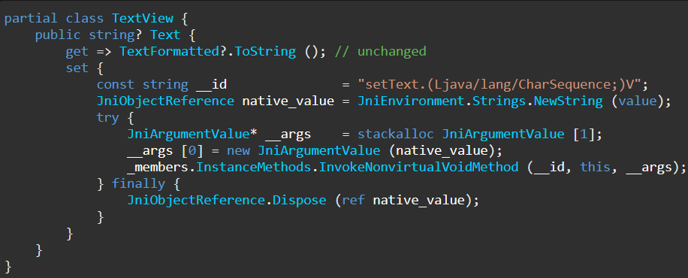
Android: Improvements in Java interop

Slide 10
dotnet-trace, dotnet-gcdump
New, simplified dotnet-dsrouter commands:
dotnet-dsrouter android
dotnet-dsrouter android-emu
dotnet-dsrouter ios
dotnet-dsrouter ios-sim
dotnet-trace ps (look for dsrouter)
dotnet-trace collect -p 3248 --format speedscope
Mono now has support for dotnet-gcdump as well!
aka.ms/profile-maui

Slide 11

Resources
.NET 8 Performance Improvements in .NET MAUI aka.ms/mauiperf8
Wiki page about profiling .NET MAUI aka.ms/profile-maui
Wiki page about Memory Leaks aka.ms/maui-memory-leaks

